Slide 1


E-Learning Website
Capstone Project
Unicorn Team

Slide 2
Project Team
Supervisor
Mr. Nguyen Tat Trung
Nguyen Hong Nam
Nguyen Tuan Minh
Nguyen Tien Huy
Nguyen Minh Hieu
Nguyen Truong Hung

Slide 3
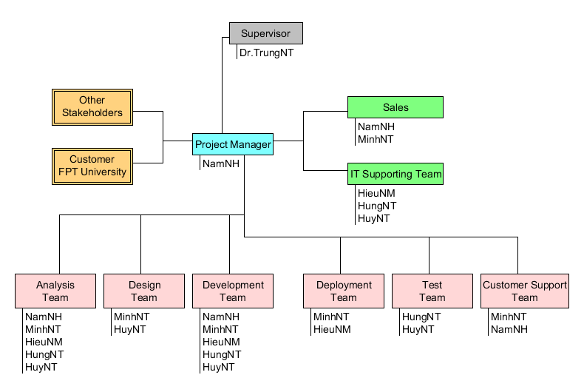
Roles and Responsibilities

Slide 4
Table Content
1
Background
2
The Existing System
3
Ideal
4
Project Management Plan
5
Software Requirement Specifications
6
Software Design Description
7
Testing
8
Demo
9
Q&A

Slide 5




Background
My E-learning system
E-learning
In the world
In Viet Nam

Slide 6
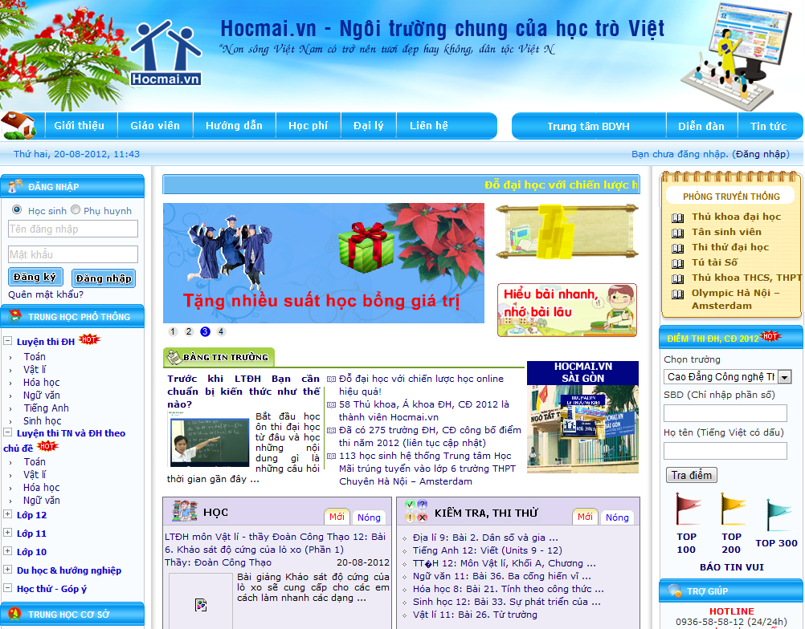

Slide 7
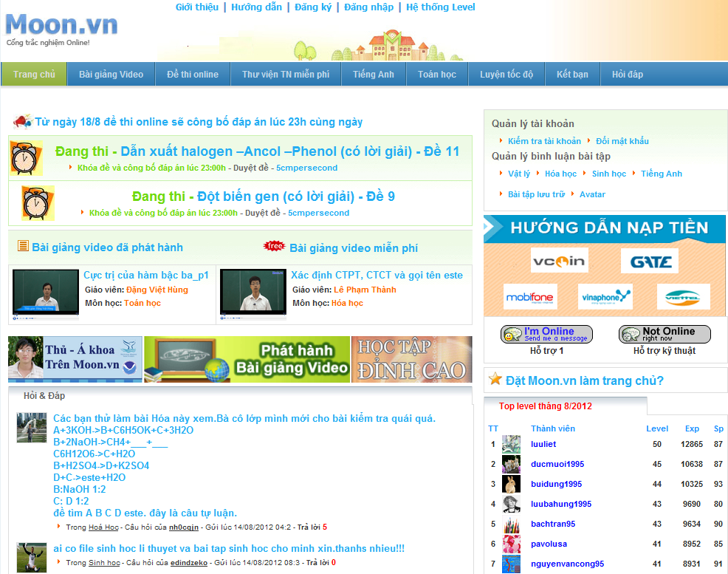

Slide 8
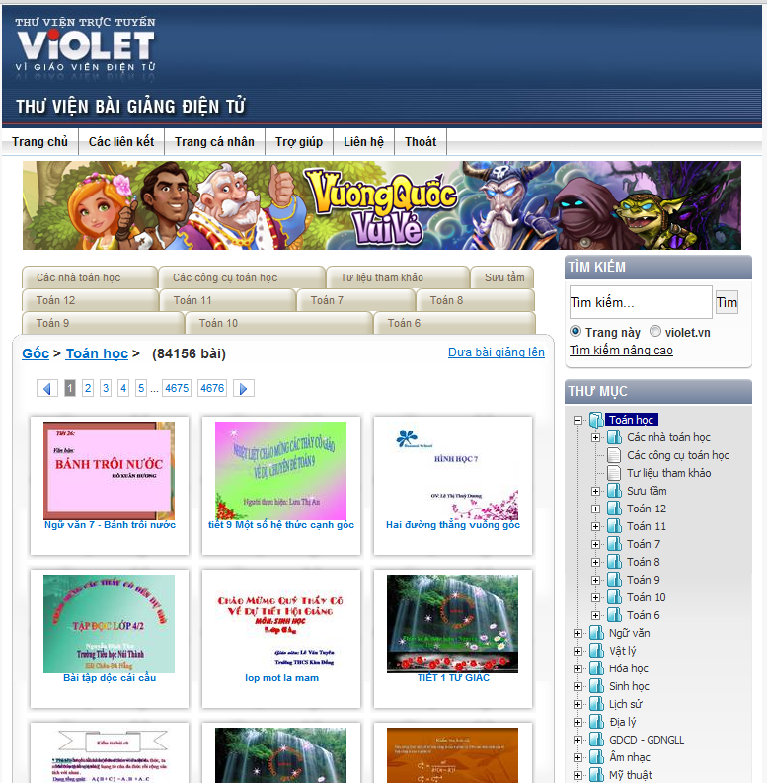

Slide 9
The Existing System
 | Advance | Disadvantage
Hocmai.vn | - Famous, teachers have many skills. - Having relations with big organizations - Having 2000 videos with full content to practice to test A, B, C, D blocks. | - The databases focus on videos of courses to make profit. Exercises, theories are updated rarely. - Forum is very large with many subjects of many grades. So it is difficult to use, manage, update. - Using for advertising of offline learning operation. So it does not focus on e-learning completely.
Moon.vn | - Focus on examination. So that, its functions support taking exam online. - Site “Hỏi đáp” is a small forum. It helps students give questions and take answers easier and fast. - User ranking function “hệ thống level” creates competition between students. - User (teachers) can give questions, exercises, exams to moon.vn to get money in return. - The function “Đấu trường” is a special attraction of moon.vn. Students can make groups and compete together in “Đấu trường”. | - The databases have been taken from many sources in internet at beginning. So that it is not updated regularly. - Does not have own good teacher. It also does not have a function to guarantee quality of exercises. - Does not have many subjects. It just focuses on some important subjects (math, English, chemistry…)
Violet.vn | - Database is uploaded by teacher. It’s free to download. | Database can’t manage well because many sources

Slide 10

Ideal
We decide to develop a system with sites below:
No | Site
1 | Home page “Trang chủ”
2 | Theories “Lý thuyết”
3 | Exercise “Thư viện bài tập”
4 | Self-study exams “Đề tự luyện”
5 | Forum “Diễn đàn”
6 | Member “Thành viên”
7 | News “Tin tức”

Slide 11
Project Management Plan
1
Software Process Model
2
Project Plan
3
Risk Management
4
Quality Plan

Slide 12
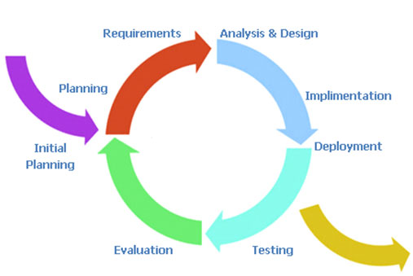
Project Management Plan (cont)
1. Software Process Model
Iterative Model
Implementing each specific part
Continue review and improvement
Report 1
Report 6
Report 2
Report 3
Report 4
Report 5

Slide 13
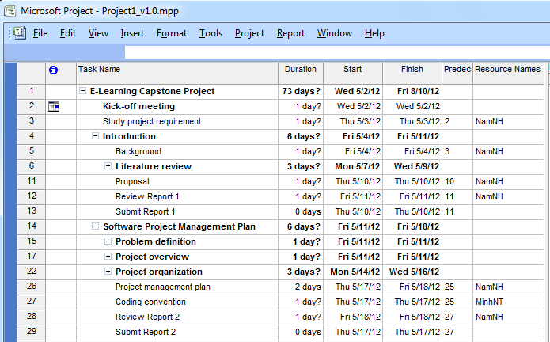
Project Management Plan (cont)
2. Project Plan

Slide 14
Project Management Plan (cont)
3. Risk Management
Risk Management
People risk
Estimation risk
Technology risk
Schedule risk
Requirement risk
Team members are ill at critical times in the project
Team members contradict each other
Team member lack the skills required
The size of the project is not estimated.
Software that used to develop the system is not free, beta version…
Overestimated time requires doing tasks.
Requirements are not defined clearly, inconsistency in defined SRS.

Slide 15
Project Management Plan (cont)
4. Quality Plan
Deliverable | Quality Event | Quality Materials | Purpose
Preliminary Use Case | Expert Review | Approved Use Case for Project | Ensure the information is accurate and well-constructed prior to submission to Consumer.
Final Use Case | Formal Inspection by Sponsor | Template for Use Case | Ensure the Use Case is in a fit state to be submitted.
Project Definition | Walk-through of early draft | Template for Project Definition | Review early draft for completeness
 | Review of final draft |  | Review final draft for completeness and construction.
Database Design | Expert Review of physical model | Standard for Database Design | Compliance with standard General accuracy.

Slide 16
Success Criteria
The project that finishes in scheduled time, within the allocated budgets and which satisfies the customer requirements.
1
All high-priority functionality defined in the requirements specification is delivered in the first release.
2
3
Open-sources are optimized closely, less complexity, improving quality of the system.
4
The estimated number of residual defects does not exceed 5 per function point.

Slide 17
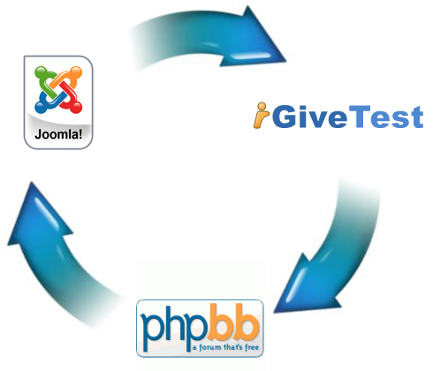
Software Requirement Specification
Functional Requirement
Open Sources Integration
Our work in integration contain 3 main parts are:
Joomla 1.5.26
iGiveTest 2.0
Phpbb 3.0.10
To integrate 3 parts our group must perform 3 steps
Synchronization databases
Implement tools
Integration modules

Slide 18
Software Requirement Specification
1. Open Sources Integration:
Synchronization databases
Synchronize login/logout of Joomla and Pbpbb by an extension of Joomla.
About iGiveTest and Joomla, we synchronize in their similar columns tables: users and groups(both open sources have those tables)

Slide 19
Software Requirement Specification
Implement tools
To synchronize Joomla and Phpbb, we will use extensions of Joomla: RokBridge.
What is RokBridge?
How to use?
Integration modules
Get password in Phpbb
Add authority for user
Logout the system

Slide 20
Software Requirement Specification
Functional Requirement
Exercise Library:
Select subject
Select chapter
Select theory(Optional)
Select difficulty of question
View questions follow the selections
View answer of questions

Slide 21
Software Requirement Specification
Non-functional Requirement
Maintainability
Extensibility
Portability
Notes:
Tránh ko đc dùng 24/7

Slide 22
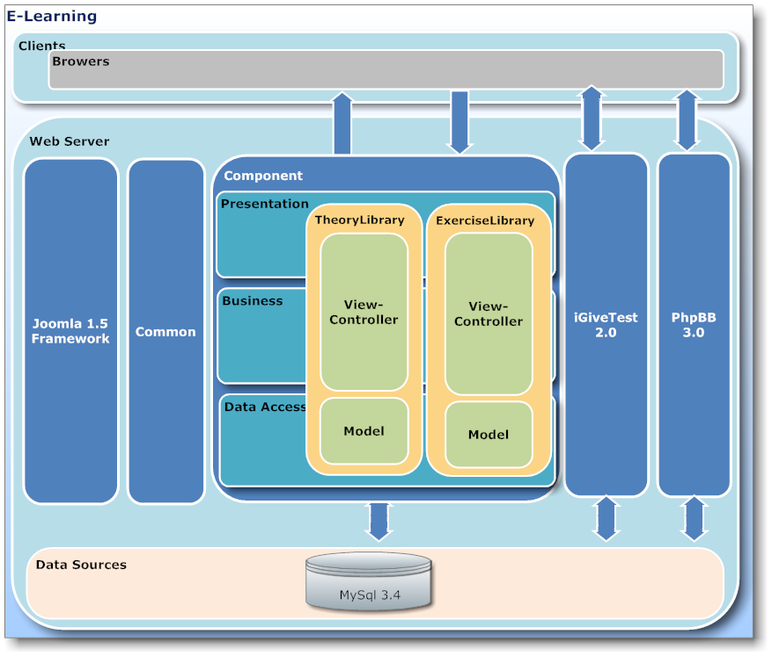
Software Design Description
System Architectural Design

Slide 23
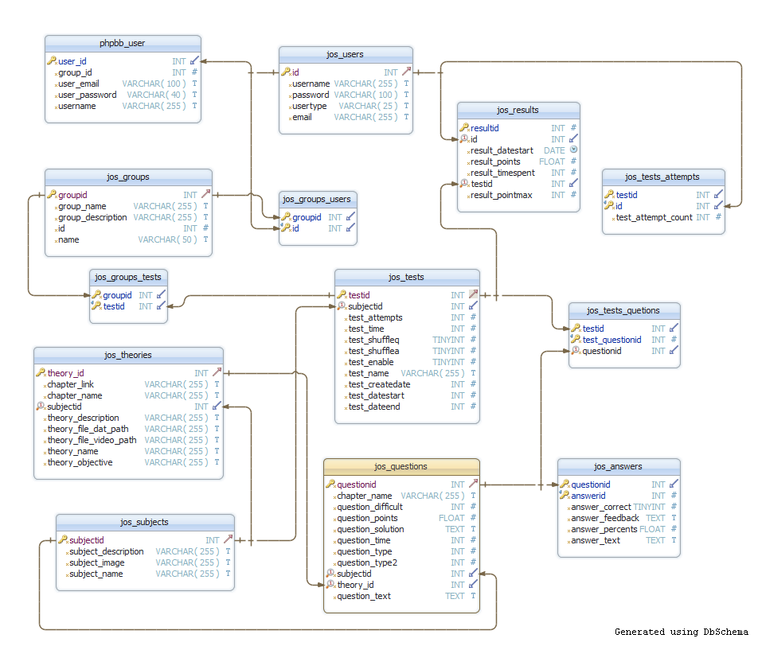
Software Design Description
Database Structure

Slide 24
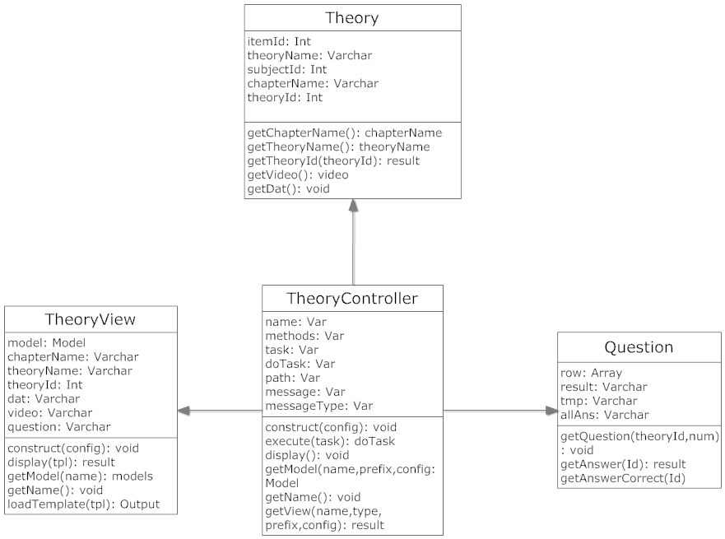
Software Design Description
Class Diagram

Slide 25
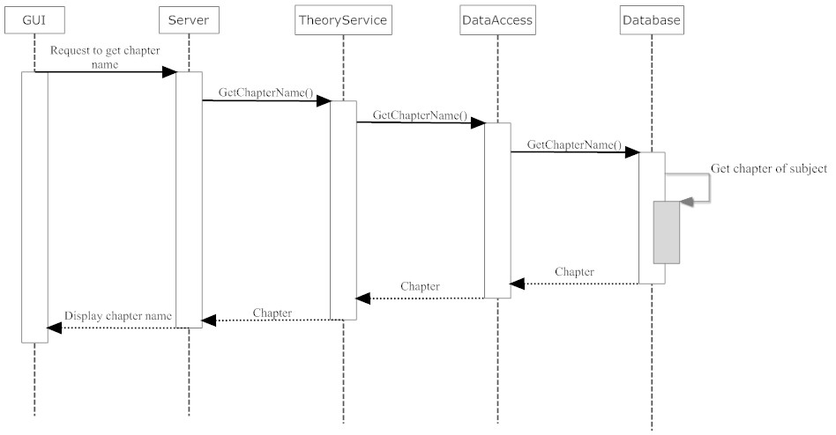
Software Design Description
Sequence Diagram

Slide 26
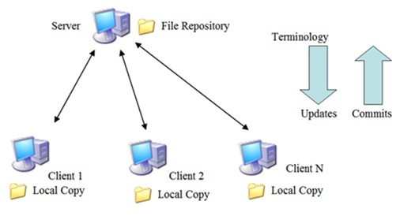
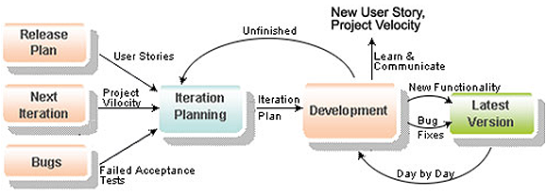
Testing
Controlling and Monitoring
Source code
Code repository
Subversion
Team member
Meeting
Assign task
Tracking task
Issue resolve
Review task
Report

Slide 27

Testing (cont)
Communication control
Online activity
Email
Google group
Chat
Phone
Offline activity
Kick-Off project
Daily and weekly meeting
Working together from Mon to Sat
Team building

Slide 28
Testing (cont)
Test plan:
Test Stage
Type of Test | Stage of Test
 | Unit | Intergration | System
Functional Test | X | X | X
User Inteface Test
Data Volume Test
Test Schedule
Test Schedule | Start Date | Finish Date
Unit/Function Testing | 27/6/2012 | 1/8/2012
User Interface Testing | 2/8/2012 | 4/8/2012
User Acceptance Testing | 5/8/2012 | 8/8/2012

Slide 29


Slide 30
Summary
Advantage
Website in Vietnamese and free
Base on Bloom model, after learning theory has exercise of relate theory to do
Using Joomla, so can add more component in future phase
Disadvantage
Not good see Interface
Not enough expected feature
Experience Learning
Learn more experience in techniques (PHP language)
Improve team works and management technique

Slide 31


Slide 32

Thank You !

